Slide 1
Data Governance Roles and Responsibilities
IS465: Data Management and Governance

Slide 2
Outline
Data governance roles in an organization
Data management roles and responsibilities
Data stewardship and data ownership

Slide 3
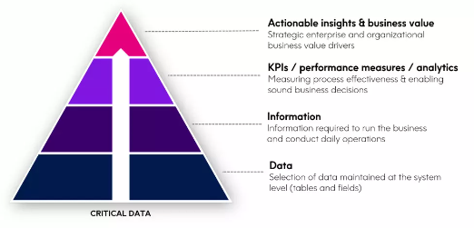
Business First Approach
Prioritize the data that matters
Link Data Governance Efforts to business goals
Iteratively pressure test model against valued added Use Cases
Build and sustain stakeholder engagement across all levels
Data Governance programs that prioritize critical data have 5x faster time-to-value

Slide 4
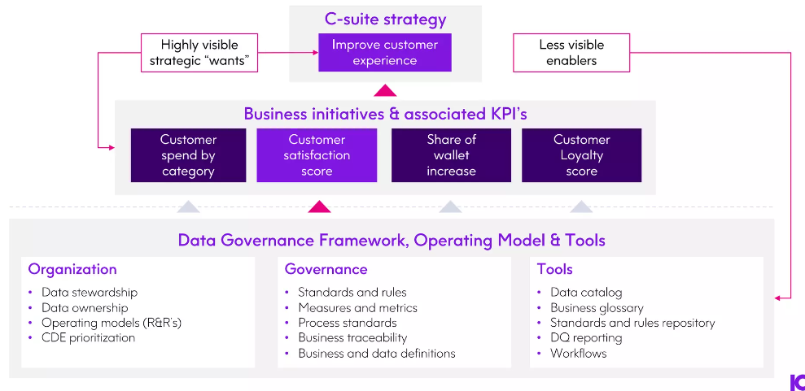
Linkage to Strategy Makes Governance Relevant

Slide 5
Data governance roles in an organization

Slide 6
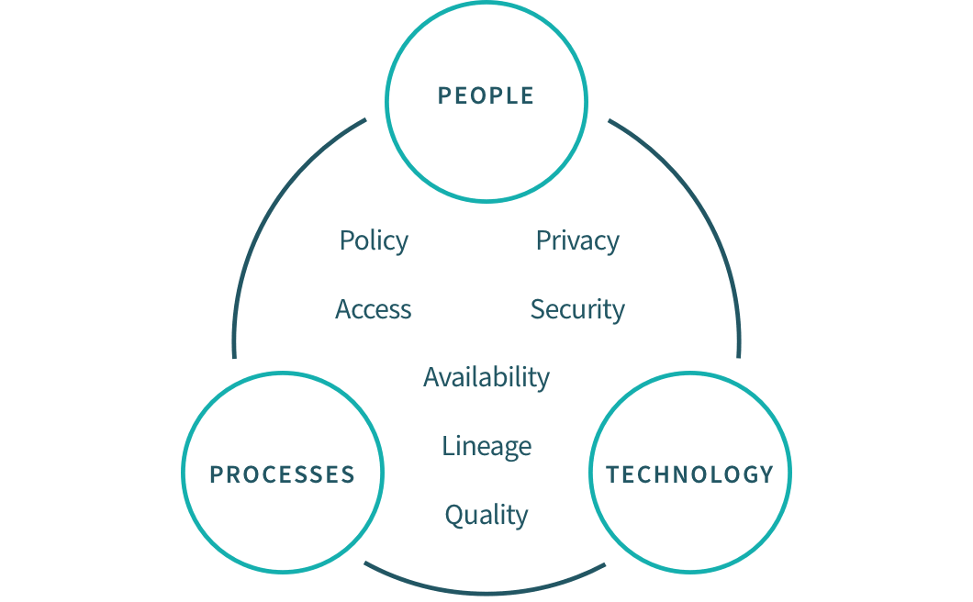
Data Governance Framework

Slide 7
Data Governance: Why It Matters
Data governance is the process of managing data quality, security, and access across an organization.
It ensures that data is accurate, complete, and accessible to the right people.
Data governance is critical for maintaining customer trust, regulatory compliance, and business success.

Slide 8
Why is it Important?
The primary benefit of data governance is providing the high-quality data necessary for data analytics and BI tools.
The insights gained from these tools result in better business decisions and improved performance.
Additional benefits include:
Improved data accuracy, completeness, and consistency
Prevention of data misuse
Agreement on common data definitions
Removal of data silos between departments and systems
Increased trust in data for analytics and decision making
Easier to locate data making all data more available
Better compliance with data privacy laws and other government regulations

Slide 9
Key Components of Data Governance
Data governance team
A cross-functional team responsible for overseeing data governance across the organization.
Data stewards
Individuals responsible for managing data within their departments or business units.
Data custodians
IT staff responsible for storing, securing, and maintaining data systems.
Data policies
Formal policies and procedures that govern data management and use.

Slide 10
Key Components of Data Governance
Data standards
Standardized formats and definitions for data elements and attributes.
Data catalogs
Centralized inventories of data assets and their metadata.
Data quality tools
Software tools used to monitor and improve data quality.

Slide 11
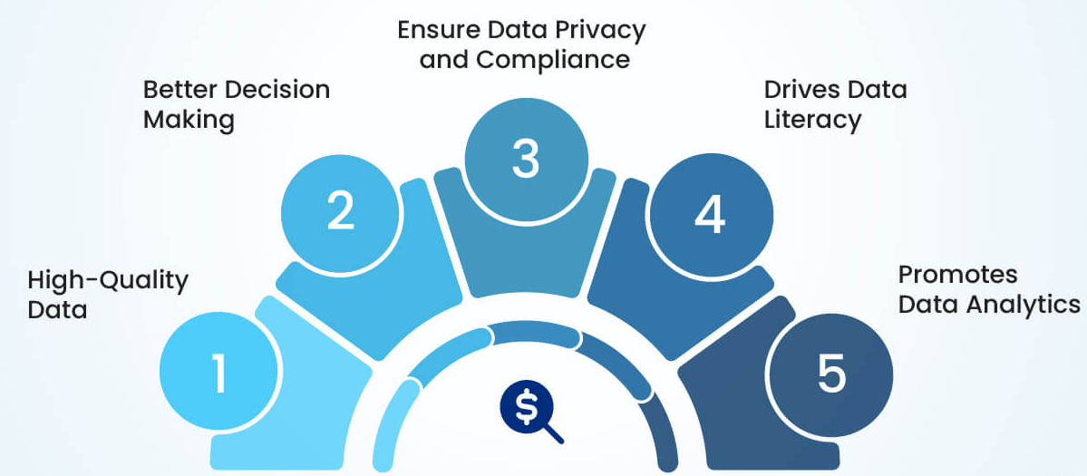
Benefits of Data Governance

Slide 12
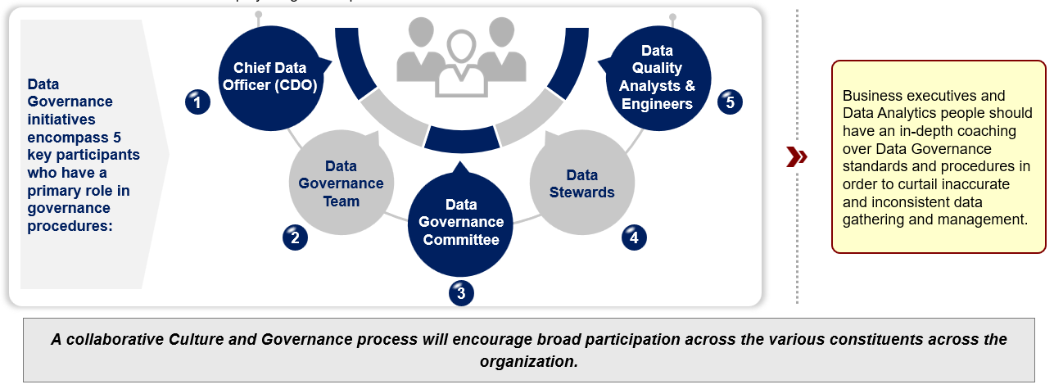
Data Governance Roles
Data governance roles are the different positions and responsibilities within an organization that are responsible for managing data.
These roles are critical for ensuring data quality, security, and compliance.

Slide 13
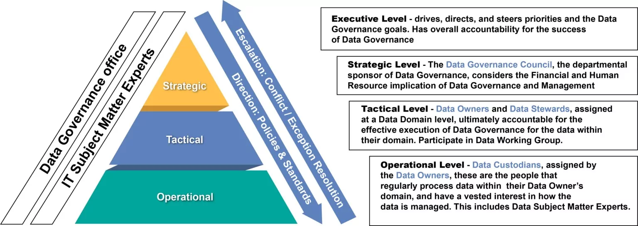
Stakeholder Levels

Slide 14
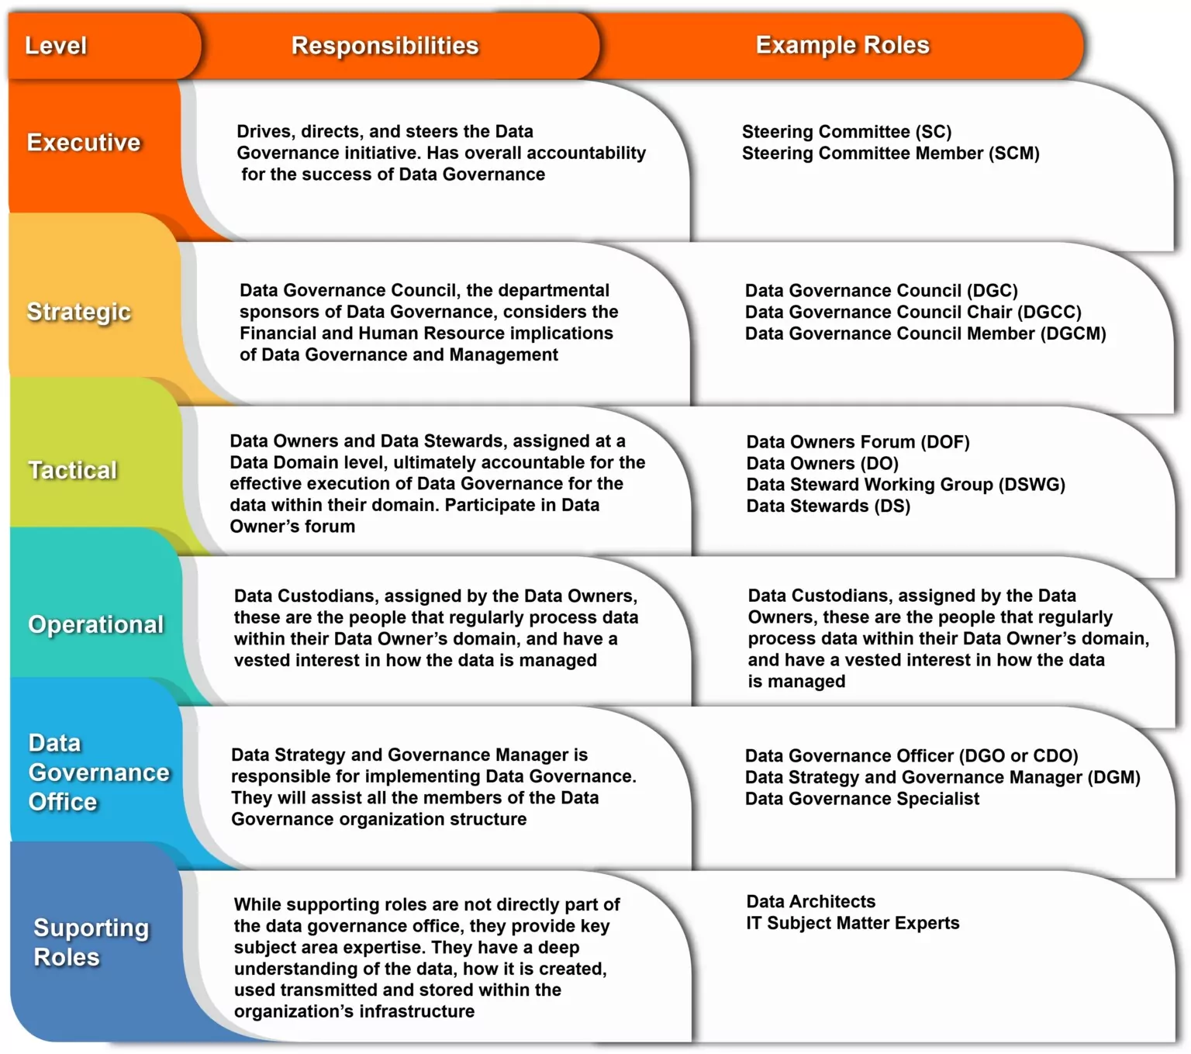
Establish Roles and Responsibilities

Slide 15
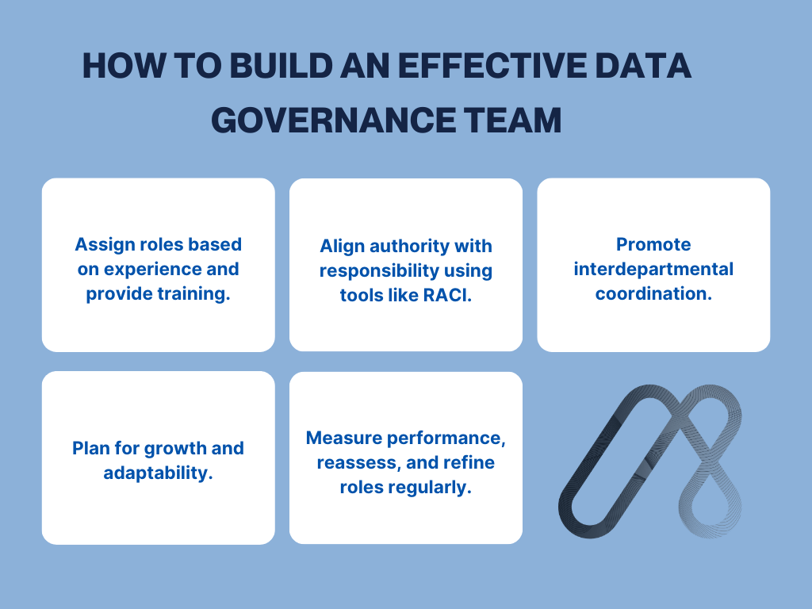

Slide 16
Data Governance Roles and Responsibilities
Data governance roles and responsibilities are the specific positions and tasks within an organization that are responsible for managing data.
Data Governance Team
Data Steward
Data Custodian
Data Analyst
Data Quality Analyst
Data Security Officer

Slide 17
Data Governance Team
The Data Governance Team is responsible for overseeing data governance across the organization.
The Data Governance Team is a cross-functional team that includes representatives from different departments and business units.
Responsible for developing and implementing data governance policies and procedures.
Ensures that data governance policies and procedures are communicated and enforced across the organization.
Monitors and reports on data governance compliance and makes recommendations for improvements.

Slide 18
Data Steward
Data Stewards are responsible for managing data within their department or business unit.
Data Stewards are individuals responsible for managing data within their department or business unit.
Responsible for ensuring that data is accurate, complete, and consistent.
Ensure that data is accessible to authorized personnel and that data security and privacy are maintained.
Work closely with the Data Governance Team to ensure that data governance policies and procedures are followed.

Slide 19
Data Custodian
IT staff responsible for storing, securing, and maintaining data systems.
Responsible for the technical management of data systems, including data storage, security, and maintenance.
Their role includes ensuring data systems are running smoothly, efficiently, and securely, and that data is properly backed up and recovered in case of system failures or other disruptions.
Work closely with the Data Governance Team to ensure that data systems are aligned with organizational data governance policies and procedures.
Ensures that data access controls are in place and that data is properly secured against unauthorized access or breaches.
Monitor data systems for potential security risks and work with the Data Security Officer to address any security concerns.

Slide 20
Data Analyst
An individual responsible for analyzing data and creating reports.
Responsible for analyzing data to support business decision-making, strategic planning, and operational optimization.
Their role includes creating reports, dashboards, and other visualizations to help stakeholders understand data trends and patterns.
Work closely with the Data Governance Team to ensure that data is accurate, complete, and consistent, and that data analysis is conducted in accordance with organizational data governance policies and procedures.
Works with data stewards to ensure that data is properly cataloged and inventoried, and that data quality is monitored and improved.

Slide 21
Data Quality Analyst
An individual responsible for monitoring and improving data quality.
Responsible for monitoring and improving data quality across the organization.
Their role includes identifying data quality issues, developing data quality metrics, and implementing data quality improvement plans.
Work closely with data stewards and data analysts to ensure that data is accurate, complete, and consistent, and that data quality issues are identified and addressed.
Works with the Data Governance Team to ensure that data quality policies and procedures are in place and followed across the organization.

Slide 22
Data Security Officer
An individual responsible for ensuring data security and compliance.
The Data Security Officer is responsible for ensuring that organizational data is properly secured and protected against unauthorized access, breaches, or other security threats.
Their role includes developing and implementing data security policies and procedures, conducting security audits and risk assessments, and ensuring compliance with relevant data security regulations and standards.
Work closely with the Data Governance Team to ensure that data security policies and procedures are aligned with organizational data governance policies and procedures.
Works with data custodians and data analysts to ensure that data systems are properly secured and that data access controls are in place.

Slide 23
Training & Development for Data Governance Roles
Orientation Program
Tool Training
Cross-Functional Training
Mentoring and Shadowing
Industry Training and Certifications
Continuous Learning Opportunities

Slide 24
Data management roles and responsibilities

Slide 25
An Overview
Data management roles and responsibilities are critical for ensuring data quality, security, and compliance.
Clearly defined roles and responsibilities help to avoid confusion and ensure that tasks are completed efficiently.

Slide 26
Data Management Roles
Enterprise Architect
Data Architect
Data Modelers
IT Managers
Data Engineers
Data Storage Managers
Big Data Analysts
Data Warehouse Architects
Data Warehouse Engineers
Data Warehouse Analysts
Business Intelligence Analysts
Master Data Managers
Data Governance Managers
Data Stewardship Managers
Data Quality Analysts
Data Operations Managers
Reference Data Managers
Data Integration Specialists
Data Interoperability Specialists
Enterprise Integration Architects
Data Scientists
Data Analysts
Business Analysts
Machine Learning Engineers
Predictive Modeling Analysts
Data Visualization Specialists
Data Monetization Strategists
Document Management Specialists
Content Management Specialists
Enterprise Content Management Architects
Information Architects

Slide 27
Different Data Management Roles
Data Architect
Database Administrator (DBA)
Data Analyst
Data Scientist
Data Manager
Data Modeler
Data Quality
Data Engineer

Slide 28
Data Architect
Responsible for designing and maintaining the overall data architecture of an organization, including data storage, processing, and retrieval systems.
Develops and implements data management strategies, policies, and standards to ensure data quality, security, and compliance with regulations.
Collaborates with data scientists, data analysts, and other stakeholders to ensure that data architecture meets business needs and supports data-driven decision-making.
Identifies and evaluates new technologies and techniques for data management and makes recommendations for their adoption.

Slide 29
Data Manager
Responsible for managing the day-to-day operations of an organization's data management function, including data management staff, budgets, and resources.
Collaborates with data architects to develop and implement data management strategies, policies, and standards.
Ensures that data management systems and processes are compliant with regulations and meet business needs.
Develops and implements data governance and quality control processes to ensure the accuracy, completeness, and consistency of data.

Slide 30
Database Administrator (DBA)
Responsible for the management, maintenance, and performance of an organization's databases, including database design, development, and optimization.
Ensures data security, privacy, and compliance with regulations, and troubleshoots database issues and errors.
Collaborates with data analysts and data scientists to ensure that database structures and configurations meet business needs.
Develops and implements database documentation, standards, and best practices.

Slide 31
Data Analyst
Responsible for collecting, organizing, and analyzing data to support business decision-making and strategy.
Develops and maintains databases, data warehouses, and other data storage systems to support data analysis and reporting.
Creates reports, visualizations, and dashboards to communicate data insights to stakeholders.
Collaborates with data scientists to develop predictive models and machine learning algorithms to solve business problems.

Slide 32
Data Scientist
Responsible for developing and applying machine learning models, statistical models, and other advanced analytics techniques to solve complex business problems.
Collaborates with data analysts and data engineers to design and implement data pipelines and ensure data quality.
Develops and maintains data visualizations and other tools to communicate insights and results to stakeholders.
Collaborates with data architects and data managers to ensure that data management strategies and systems support the needs of data science.

Slide 33
Data Modeler
Responsible for designing and maintaining data models to support data management and analysis.
Collaborates with data architects and data scientists to develop and implement data models that meet business needs and support data-driven decision-making.
Develops and maintains data dictionaries and other metadata to document and communicate data models and data relationships.
Ensures that data models are compliant with data management standards and best practices.

Slide 34
Data Quality
Responsible for ensuring the accuracy, completeness, and consistency of an organization's data.
Collaborates with data managers and data analysts to develop and implement data quality control processes and procedures.
Identifies and resolves data quality issues and defects, and develops and implements data quality metrics and reporting.
Ensures that data quality processes and procedures are compliant with regulations and meet business needs.

Slide 35
Data Engineer
Responsible for designing, building, and maintaining the infrastructure and tools needed to support data management and analysis.
Collaborates with data architects and data scientists to develop and implement data pipelines and ensure data quality.
Develops and maintains data processing and storage systems, including data warehouses, data lakes, and other data storage solutions.
Ensures that data engineering systems and processes are compliant with regulations and meet business needs.

Slide 36
Importance of Data Management
Data management allows organizations to make better decisions based on reliable insights into customer behavior, market trends and other aspects affecting performance.
In addition, it helps them save time and money by optimizing processes as well as minimize risks associated with storing sensitive information.

Slide 37
Benefits of Effective Data Management
Effective data management can lead to improved customer service through faster response times due to efficient search capabilities.
It also reduces redundancy by eliminating duplicate entries which would otherwise take up unnecessary time and money spent manually verifying each entry separately.
Furthermore it improves decision-making processes by collecting all relevant data points quickly which would otherwise require different teams manually searching through vast stores of product info in order to make informed decisions.

Slide 38
Data stewardship and data ownership

Slide 39
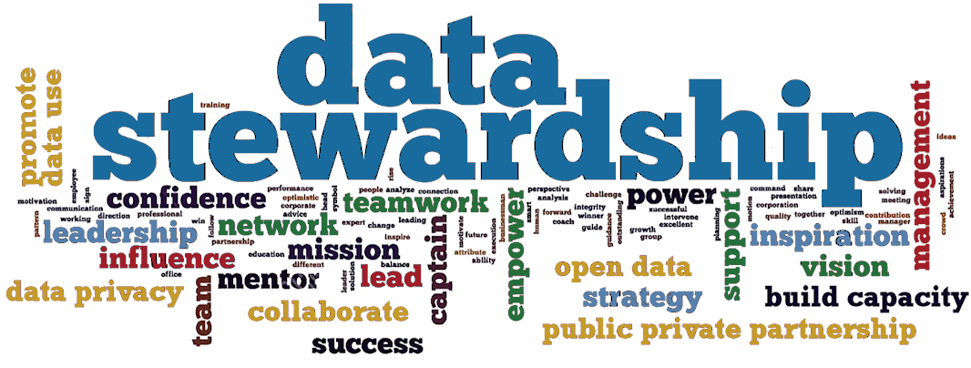
Data Stewardship
A Key Component of Data Governance
Data stewardship refers to the management and oversight of an organization's data assets to ensure their quality, security, and accessibility.
Importance of data stewardship in data governance:
Data stewardship is a critical component of data governance, as it ensures that data is properly managed and utilized across an organization.

Slide 40
Data Stewardship Roles and Responsibilities
Data stewardship roles:
Data owner: The person or group responsible for the accuracy, completeness, and integrity of the data.
Data custodian: The person or group responsible for the security, storage, and retrieval of the data.
Data user: The person or group that uses the data to perform their job functions.
Responsibilities:
Data quality: Ensuring the accuracy, completeness, and integrity of the data.
Data security: Protecting the data from unauthorized access, corruption, or loss.
Data accessibility: Ensuring that data is accessible to authorized users.
Data retention: Ensuring that data is properly stored and retained according to organizational policies and legal requirements.

Slide 41
Data Stewardship Best Practices
Data quality:
Validate data inputs
Use data validation rules
Perform data quality checks
Data security:
Implement access controls
Use encryption
Monitor data access and usage
Data accessibility:
Use data catalogs and inventories
Provide data access training
Implement data search and retrieval tools
Data retention:
Implement data retention policies
Use data archiving and backups
Monitor data storage and retrieval

Slide 42
Data Stewardship in the Digital Age
The digital age has brought about an explosion of data, making data stewardship more critical than ever.
Emerging technologies such as AI, machine learning, and the cloud have created new challenges and opportunities for data stewardship.
Data stewardship must evolve to keep pace with the changing technology landscape.

Slide 43
Data Stewardship Challenges
Data volume and complexity
The sheer volume and complexity of data can make it difficult to manage and govern.
Data silos
Data silos can lead to data duplication, inconsistencies, and security risks.
Data privacy and regulations
Ensuring compliance with data privacy regulations such as GDPR and CCPA can be a challenge.
Data security threats
Cyber attacks and data breaches pose a significant threat to data security.

Slide 44
Data Stewardship Benefits
Improved data quality
Data stewardship helps ensure that data is accurate, complete, and consistent.
Increased data trust
Data stewardship builds trust in the data, enabling better decision-making and improved business outcomes.
Compliance with regulations
Data stewardship helps ensure compliance with data privacy regulations and reduces the risk of data breaches.
Better data management
Data stewardship enables better management of data assets, improving data accessibility and reducing data duplication.

Slide 45
Data Ownership
A Key Component of Data Governance
Definition of data ownership:
Data ownership refers to the individual or group responsible for the accuracy, completeness, and integrity of a specific dataset.
Importance of data ownership in data governance:
Data ownership is a critical component of data governance, as it ensures that data is properly managed and utilized across an organization.

Slide 46
Data Ownership Roles and Responsibilities
Data owner
The person or group responsible for the accuracy, completeness, and integrity of the data.
Data custodian
The person or group responsible for the security, storage, and retrieval of the data.
Data user
The person or group that uses the data to perform their job functions.

Slide 47
Data Ownership Roles and Responsibilities
Responsibilities:
Data quality
Ensuring the accuracy, completeness, and integrity of the data.
Data security
Protecting the data from unauthorized access, corruption, or loss.
Data accessibility
Ensuring that data is accessible to authorized users.
Data retention
Ensuring that data is properly stored and retained according to organizational policies and legal requirements.

Slide 48
6 Differences between Data Steward vs Data Owner
Criteria | Data Owner | Data Steward
Focus | Strategic decision-making, accountability, authorization | Operational tasks, data quality, governance
Background | Typically senior business or management role | Subject matter expert, may or may not be IT background
Responsibility | Owns the data, makes final decisions on access and use | Manages the data on a day-to-day basis, ensures quality and compliance
Security | Ensures data security measures are in place | May play a role, but not the primary focus
Accountability | Held accountable for the data | Accountable to the data owner for activities

Slide 49
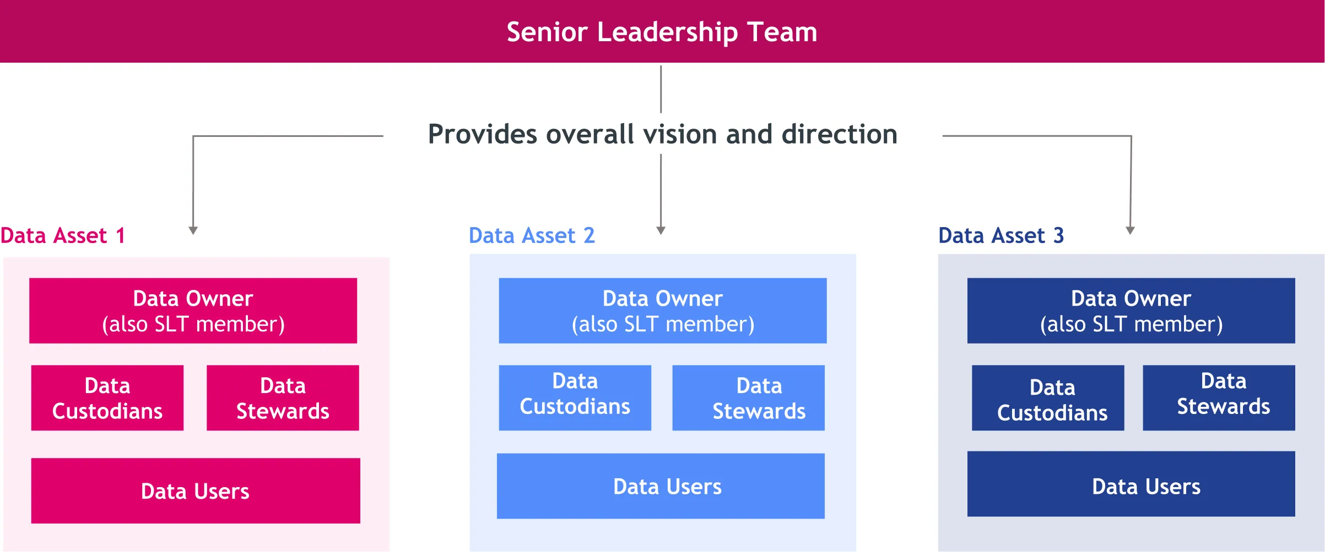
What’s the difference?

Slide 50
Final Thoughts and Call to Action
Data governance is a continuous process that requires ongoing efforts and commitment.
Implementing data governance can seem daunting, but it's essential for ensuring data integrity, security, and compliance.
Start by identifying your organization's data governance needs and developing a data governance strategy.
Assign clear roles and responsibilities, develop policies and procedures, and establish regular monitoring and reporting processes.
Don't wait – start implementing data governance today to ensure your organization's data is accurate, secure, and compliant.

